Slide 1

Reinforcement Learning

Slide 2
Deep Learning
Now it is time to learn about Reinforcement Learning!
We’ll also discuss how to use OpenAI’s gym library to

Slide 3
Deep Learning
OpenAI
OpenAI is a non-profit AI research company, discovering and enacting the path to safe artificial general intelligence.

Slide 4
Deep Learning
OpenAI
Backed by YCombinator, Elon Musk,

Slide 5
Reinforcement Learning
Overview

Slide 6
Deep Learning
What is Reinforcement Learning?
It allows machines and software agents to automatically determine the ideal behaviour within a specific context, in order to maximize its performance.

Slide 7
Deep Learning
What is Reinforcement Learning?
Simple reward feedback is required for the agent to learn its behaviour; this is known as the reinforcement signal.

Slide 8
Deep Learning
What is Reinforcement Learning?
There are many different types of algorithms that fall under Reinforcement Learning.
Not all of them require a framework such as TensorFlow!

Slide 9
Deep Learning
What is Reinforcement Learning?
Agent
Environment
Action
Reward

Slide 10
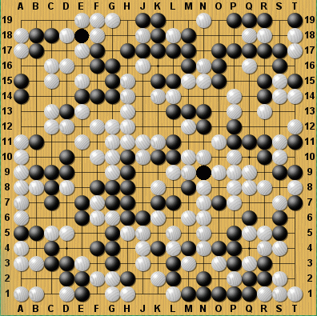

Deep Learning
Action
Agent
Observations
Reward
Environment

Slide 11
Deep Learning
Agent
Our program or bot
Can receive inputs based off the environment
Performs actions

Slide 12
Deep Learning
Environment
The actual setting the agent is interacting with.
Often a game in examples, but it can be any real world or artificial environment.

Slide 13
Deep Learning
Environment
Keep in mind you need to be able to represent this environment in a way an agent can understand (probably needs to be an array in the end)

Slide 14
Deep Learning
Environment
Previously it was very difficult to create environments that were easy to use and shareable.
Later on we’ll discover how OpenAI’s gym library solves this!

Slide 15
Deep Learning
Action
The actual interaction your agent will perform on the environment.
Moving in an environment, choosing the next move in a game, etc...

Slide 16
Deep Learning
Reward
The metric that allows your agent to understand whether or not the previous sets of actions helped or hurt in its overall goal.

Slide 17
Deep Learning
These four aspects are fundamental to Reinforcement Learning.
The OpenAI Gym works with variables designed to fit within this framework, allowing us to focus on model building.

Slide 18
Deep Learning
Keep in mind, Reinforcement Learning isn’t just for games!
Games are just an easy way to clearly show all the major aspects of reinforcement learning.

Slide 19
OpenAI Gym

Slide 20
Deep Learning
OpenAI
OpenAI is a non-profit AI research company, discovering and enacting the path to safe artificial general intelligence.

Slide 21
Deep Learning
OpenAI Gym
Toolkit that aids in developing and comparing reinforcement learning algorithms.

Slide 22
Deep Learning
OpenAI Gym Library
Python library with a collection of environments that you can use with your reinforcement learning algorithms

Slide 23
Deep Learning
OpenAI Gym Service
A site and API where you can compare algorithm performance.

Slide 24
Deep Learning
Let’s explore the official documentation before diving into working with OpenAI Gym with Python!
gym.openai.com

Slide 25
OpenAI Gym Working with the Environment

Slide 26
Deep Learning
OpenAI
OpenAI is a non-profit AI research company, discovering and enacting the path to safe artificial general intelligence.

Slide 27
Deep Learning
The environment's step function returns exactly what we need. In fact, step returns four values. These are:
observation (object): an environment-specific object representing your observation of the environment. For example, pixel data from a camera, joint angles and joint velocities of a robot, or the board state in a board game.
reward (float): amount of reward achieved by the previous action. The scale varies between environments, but the goal is always to increase your total reward.
done (boolean): whether it's time to reset the environment again. Most (but not all) tasks are divided up into well-defined episodes, and done being Trueindicates the episode has terminated. (For example, perhaps the pole tipped too far, or you lost your last life.)
info (dict): diagnostic information useful for debugging. It can sometimes be useful for learning (for example, it might contain the raw probabilities behind the environment's last state change). However, official evaluations of your agent are not allowed to use this for learning.

Slide 28
OpenAI Gym Set-Up

Slide 29
Deep Learning
Let’s review best practices when using OpenAI with Python.

Slide 30
Deep Learning
Recommended Environment
A text editor (Sublime , Atom)
IDE - PyCharm
Code out .py scripts in editor
Execute code at command line.
Many possible plugins for Python!

Slide 31
Deep Learning
OpenAI does technically work in Jupyter Notebook, but running multiple renderings can sometimes lead to freezing.

Slide 32
Deep Learning
Let’s quickly check that OpenAI Gym is installed and how to run a .py script
NOTE: Please feel free to use any IDE configuration you prefer!

Slide 33
Deep Learning
We’ll use Atom for this series of lectures, remember that you have many options, including just sticking with Jupyter Notebooks!
Go to: atom.io

Slide 34
Gym Environments

Slide 35
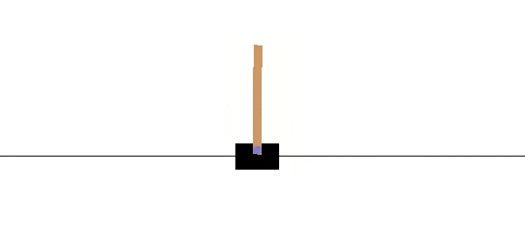
Deep Learning
Let’s explore how to create an example environment with OpenAI Gym!

Slide 36
Deep Learning
Goal of CartPole environment is to balance the pole on the cart.

Slide 37
Deep Learning
Actions allow us to move the cart left and right to attempt to balance the pole.
0: Left
1: Right

Slide 38
Deep Learning
Environment is a numpy array with 4 floating point numbers

Slide 39
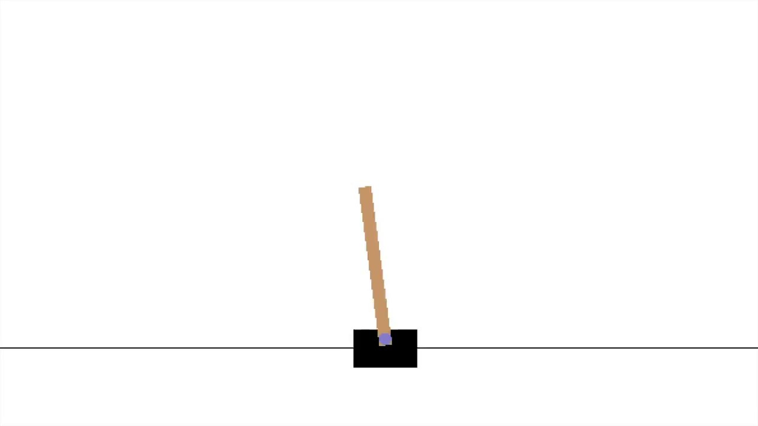
Deep Learning
[Horizontal Position,Horizontal Velocity, Angle of Pole, Angular Velocity]
Angle
Angular Velocity
Velocity
0

Slide 40
Deep Learning
You can grab these values from the environment and use them for your agent
Angle
Angular Velocity
Velocity
0

Slide 41
Deep Learning
Let’s create the environment!

Slide 42
Gym Observations

Slide 43
Deep Learning
The environment step() function we saw earlier returns back useful objects for our agent.

Slide 44
Deep Learning
observation
Environment specific information representing environment observations
Examples:
Angles, Velocities, Game States, etc...

Slide 45
Deep Learning
reward
Amount of reward achieved by previous action
Scale varies based off environment, but agent should always want to increase reward level

Slide 46
Deep Learning
done
Boolean indicating whether environment needs to be reset.
Example:
Game is lost, Pole Tipped Over, etc...

Slide 47
Deep Learning
info
Dictionary object with diagnostic information, usually used for debugging.

Slide 48
Deep Learning
Let’s explore what this looks like in practice!

Slide 49
Gym Actions

Slide 50
Deep Learning
Let’s create a very simple policy. Move the cart to the right if the pole falls to the right and vice versa.

Slide 51
Simple Neural Network

Slide 52
Deep Learning
Let’s design a simple Neural Network that takes in the observation array passes it through a hidden layer and outputs 2 probabilities, one for left and another for right.

Slide 53
Deep Learning
We will then choose a random action, weighted by the probabilities.
Let’s diagram this network

Slide 54
Deep Learning
Multinomial Sampling Based on Probability Weights
Action
(0 or 1)
Probabilities

Slide 55
Deep Learning
Notice how we don’t just automatically choose the highest probability for our decision.
This is to balance trying out new actions versus constantly choosing well-known actions.

Slide 56
Deep Learning
Once we understand this network and code it out, we’ll explore how to take into account historic actions by learning about Policy Gradients.

Slide 57
Policy Gradients

Slide 58
Deep Learning
Our previous Network didn’t perform very well.
This may be because we aren’t considering the history of our actions, we are only considering a single previous action.

Slide 59
Deep Learning
This is often called an assignment of credit problem.
Which actions should be credited when the agent gets rewarded at time t, only actions a t-1, or the series of historical actions?

Slide 60
Deep Learning
We solve this problem by applying a discount rate.
We evaluate an action based off all the rewards that come after the action, not just the first immediate reward.

Slide 61
Deep Learning
We choose a discount rate, typically around 0.95-0.99.
Then we use this to apply a score to the action with a formula:
R is Reward , D is discount Rate
R_{t=0}+ R_{t=1}D + R_{t=2}D² + R_{t=3}D³ + ….. +R_{t=n}D^{n}

Slide 62
Deep Learning
Closer D is to 1, the more weight future rewards have. Closer to 0, future rewards don’t count as much as immediate rewards
Score:
R is Reward , D is discount Rate
R_{t=0}+ R_{t=1}D + R_{t=2}D² + R_{t=3}D³ + ….. +R_{t=n}D^{n}

Slide 63
Deep Learning
Choosing a discount rate often depends on the specific environment and whether actions have short or long term effects.
Score:
R is Reward , D is discount Rate
R_{t=0}+ R_{t=1}D + R_{t=2}D² + R_{t=3}D³ + ….. +R_{t=n}D^{n}

Slide 64
Deep Learning
Let’s quickly diagram this formula!
Score:
R is Reward , D is discount Rate
R_{t=0}+ R_{t=1}D + R_{t=2}D² + R_{t=3}D³ + ….. +R_{t=n}D^{n}

Slide 65
Deep Learning
Pole Goes Up
Pole Goes Up
Pole Falls Over
Actions
Rewards
Right 1
+10
Left 0
+10
Right 1
-100

Slide 66
Deep Learning
Pole Goes Up
Pole Goes Up
Pole Falls Over
Actions
Rewards
Right 1
+10
Left 0
+10
Right 1
-100

Slide 67
Deep Learning
Pole Goes Up
Pole Goes Up
Pole Falls Over
Actions
Rewards
Sum of
Discount Rewards
Right 1
+10
Left 0
+10
Right 1
-100
-70.75 = 10 + (0.95)*10 + (0.95)²(-100)

Slide 68
Deep Learning
Because of this delayed effect sometimes good actions may receive bad scores due to bad actions that follow, unrelated to their initial action.
To counter this, we train over many episodes.

Slide 69
Deep Learning
We also then must normalize the action scores by subtracting the mean and dividing by the standard deviation.
These extra steps can significantly increase training time for complex environments.

Slide 70
Deep Learning
Implementing this Gradient Policy with Python and TensorFlow can be complex, so let’s go over the steps that we will perform!

Slide 71
Deep Learning
Neural Network plays several episodes.
The optimizer will calculate the gradients (instead of calling minimize)
Compute each action’s discounted and normalized score.

Slide 72
Deep Learning
Then multiply the gradient vector by the action’s score.
Negative scores will create opposite gradients when multiplied.
Calculate mean of the resulting gradient vector for Gradient Descent.

Slide 73
Deep Learning
Because of the complexity of manually implementing Policy Gradient techniques with TensorFlow, we encourage you to check out the extra resources for additional examples and explanations!
Let’s get started!

